Slide 1
Polish workers in the UK
Their involvement with unions and their employment rights
Labour Research Department
26 November 2016

Slide 2
Issued to be covered
Polish workers in the labour market
Polish workers and unions
Polish workers and their employment rights

Slide 4
Occupations

Slide 5
How employed
More likely to be employed through agencies
“There are significantly more agency workers who are from a minority group (including Eastern Europeans) compared with all employees.” BIS 2008
70% of workers supplied to meat and poultry indutry were migrant workers, with Polish being the largest nationality. EHRC 2010
More likely to be employed through gangmasters
“64% came from A8 countries: with the Polish by far the most numerous (making up 87% of all A8 citizens)” GLA 2008

Slide 6
Polish and UK unions
Similarities between UK and Polish unions
Membership lower in private sector
Pay set at company level
No “works councils”
Differences between Polish and UK unions
Only one union confederation (TUC)
No social dialogue structure
UK unions not founded at workplace level

Slide 7
Polish participation in unions
Union density among all employees: 25.0%
Union density among Polish employees: 8.2%
Differences in part explained by industries and jobs

Slide 8
Polish participation in unions
Polish workers are in industries and jobs where union density is lower and not where it is higher
Industries
26.4% in manufacturing (union density – 18.0%)
3.6% in education (union density 50.3%)
1.1% in public administration (union density 49.8%)
Jobs
6.0% work as professionals (union density 43.7%)
32.7% in elementary occupations (union density15.9%)

Slide 9
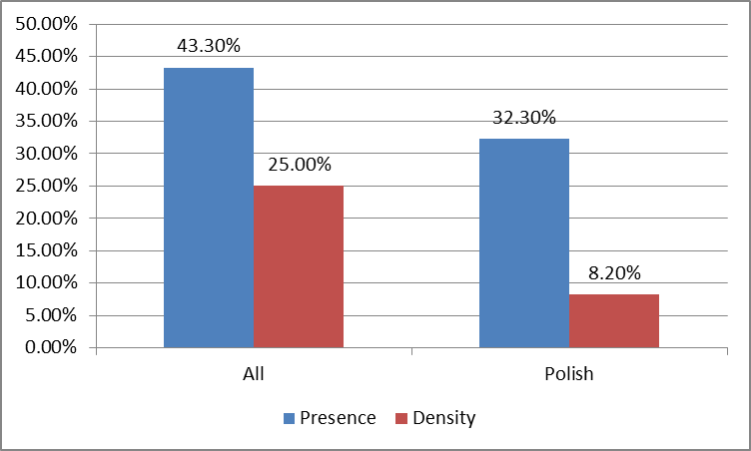
Gap between union presence and density

Slide 10
Other factors explain lower density
Employed as temporary workers
Overall: 25.7% density for permanent but 14.5% for temporary
Process workers: 23.8% density for permanent but 10.2% for temporary
Other factors
Language
Unfamiliarity
Fear of victimisation
Discrimination

Slide 11
Unions want to organise Polish workers
New unionism in 1998 - aim
“to develop a culture of organising that could help to transform unions by bringing in new and diverse members.”
New developments provided resources for this
Union Modernisation Fund – funds from government to help unions (ended 2010)
unionlearn – funds for government for training

Slide 12
Example of a union campaign
UNISON – migrant workers’ participation project
Aims:
to increase migrant workers’ participation in the union;
to ensure that there were participating at all levels;
to bring migrant workers’ concerns into the mainstream of bargaining at the workplace;
to reduce the exclusion of migrants in the workplace; and
to make the services UNISON offers more relevant to migrant workers.
Ran 2008 to 2010

Slide 13
But remains limited and precarious
Most specific campaigns ended when Union Modernisation Fund ended
“the UMF project gave UNISON the opportunity to do an important piece of work that otherwise would not have happened” UNISON organiser 2010
Since then
Continues where part of ongoing campaign
Relies on new Polish officials and activists

Slide 14
Polish workers’ employment rights: background
No single Labour Inspectorate (no PIP)
Existing inspection and enforcement regimes being reduced – switch to risk-based approach
Health and Safety Executive
Local authorities
Gamgmasters Licensing Authority
No statistics on whether rights are respected

Slide 15
Enforcement of employment rights – through legal court cases
Until 2013-14 approximately 60,000 to 70,000 cases a year in Employment Tribunals, although falling
July 2013: introduction of fees
£160 plus £230 if goes to court (wages, notice etc)
£250 plus £950 if goes to court (unfair dismissal, discrimantion)
By 2014-15 number of cases fallen to 21,900

Slide 16
Enforcement of employment rights – Polish workers (1.6%)
Pay and Work Rights Helpline (specific advice on some areas – minimum wage, agency work)
Polish nationals 1.1% to 1.4% of callers
Acas helpline (more general employment advice)
Polish language calls 0.19%
ET cases (employment rights court)
Up to 0.8% but probably only 0.1% to 0.13% were EU8 nationals (Barnard and Ludlow)

Slide 17
Conclusions on employment rights
“Our findings … suggest that migrants’ rights to equal treatment in the host Member State may be rights that exist more ‘on paper’ than in practice.” (Barnard & Ludlow 2015)
“The report found … widespread evidence of mistreatment and exploitation of migrant and agency workers … Many workers had little knowledge of their rights and feared raising concerns would lead to dismissal.” (EHRC report on meat and poultry industry 2010)

Slide 18
The future
Unions help to secure employment rights
“In workplaces where unions are recognised, or have a strong presence we found that they provide a significant degree of protection for workers”. EHRC
But unions are likely to be weakened through Trade Union Bill
Overall attitude to Polish migrants may change as a result of plans to remove in-work benefits
Notes:
1.5% 1.7%
-2.7% 5.5%
1.4% 5.7%

Slide 19
Thank you for your attention
Lionel Fulton lfulton@lrd.org.uk

Slide 20
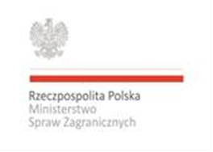
The project “Solidarity in action. Employment rights, participation in social dialogue and membership in trade unions among Polish employees in the UK” is co-financed by the Polish Ministry of Foreign Affairs within the „ Cooperation with Polish Diaspora and Poles abroad in 2015.”

